Slide 1



Pmate
Projeto em informática
22 de março de 2021

Slide 2

Team and advisors
Pedro Souto
Team Leader
Fábio Carmelino
DevOps Master
Diogo Moreira
Lead Developer
Maria Rocha
Architect
Joaquim Pinto
Co-Advisor
Luís Pereira
Product Owner
André Monteiro
Advisor

Slide 3
Context
Pmate is a contest in which students compete against each other and test their knowledge in multiple fields, such as Maths, Languages, and Science.
To manage the information regarding the users, the tests and the results of each student, there is a platform used by a few administrators that provides access to this information (stored in an SQL database).
This platform provides basic functionalities, but is outdated and unsecure.
Our job is to provide a new improved platform with the same functionalities.

Slide 4
Problems
As mentioned before, the current platform is very old, and uses technology that is no longer commonly used among the web. Various features are now obsolete, and some new features would improve QoL a lot.
There are also a number of security issues that provide a serious risk to participants.

Slide 5
Goals
Build a new platform that:
- Is easy to use
- Maintains all the essential features
- Adds new features
- Is secure
- Uses a more modern and optimized framework

Slide 6
Tasks
Implement the existing features in .NET Core [Diogo, Luís, Maria]
- Allow for external authentication (Google, Facebook, IDP UA...) [Pedro, Fábio]
- Improve the user interface and experience [Pedro]
- Implement security measures [Fábio]

Slide 7
Expected main features
Authentication
List of participants for each Pmate contest
- See the answers of a participant
Search by schools
Filter teachers related to each school

Slide 8
Expected Results
We hope to provide a complete, optimized, user-friendly application that allows for quick and easy management of users, schools, tests, and results from the PmatE events.
We also expect the final product to assure the safety of PmatE users’ data.

Slide 9
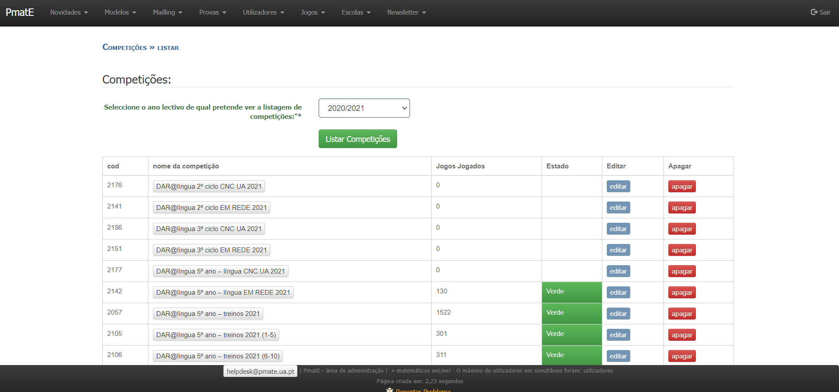
Related work
We will be basing most of our work on the existing PmatE platform.

Slide 10





Communication plan
- Project Repository (GitHub);
- Backlog Management (Jira);
- Communication with Advisors (Email);
- Team Communication (Discord);
- Weekly Meetings (Zoom);

Slide 11
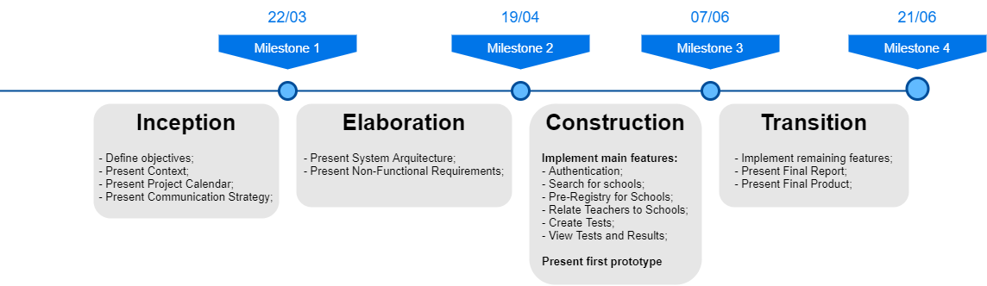
Calendar

Slide 12
Questions?

